Slide 1
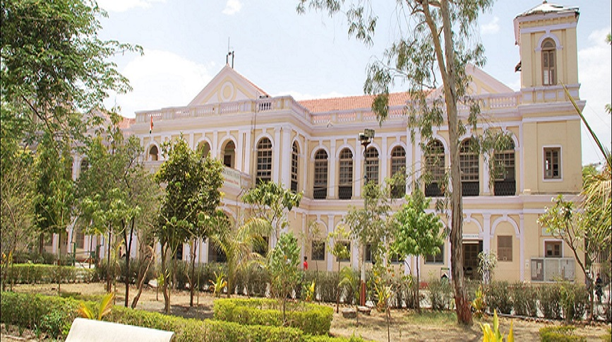
Some Thoughts and Recommendations in Spatial Data Handling
Prof. Dr. Franz-Josef Behr, Stuttgart University of Applied Sciences
Holkar Science College, Indore, Madhya Pradesh, India
Source: https://collegeholkar.org/
Notes:
A brief intro to Geoinformatics/Geomatics/GIS etc
What are the related disciplines and prerequisites to studying Geomatics
Major application areas of Geoinformatics
How it is helpful for the society (maybe urban settlement/environment)
Future trends
A brief overview of your area of expertise and of course of AGSE.

Slide 2
Outline
Introduction: About me and some thoughts about professional education
From Reality to Model
Processing the Data: GIS and other Geospatial Tools
Sharing Models and Data
Web Based Interoperability
The Significance of Fundamental Datasets
Summary

Slide 3
About me
and about
Being a Professor

Slide 4
My Background
Academia: Geodesy and Computer Science
12 years of (closed) GIS business, text book author
  Municipalities, utility sector
Professor (since 2002), huge amount of lectures and duties
Engagements in Open Source, Open Data, and Open Eductaion
  some (own) open source projects
  Involved in Open Source Conferences
  Initiator of FOSS4G SEA 2012 and FOSS4G Local Chapter Malaysia
  Co-organizer of FOSS4G 2013, FOSS4G 204, FOSS4G 2016, FOSS4G 2023
  ICA/OSGEo lab at HFT Stuttgart (virtual)

Slide 5
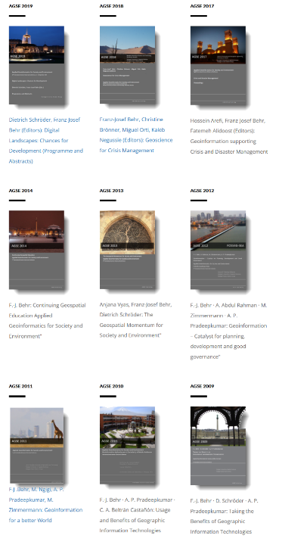


Text Books and Proceedings

Slide 6
What is our motivation for professional work?
Intrinsic interests
Earn money for living expenses
Contribution to the betterment of society and environment, i.e. for the people!
Contribution to the overall development of knowledge, i.e. the scientific, research orienteds and academic aspect

Slide 7
What is our motivation as educators
We have the vocation to support our students
  to discover their talents
  to become acquainted with scientific working principles
  to become fully qualified professionals
  to follow strict ethical and academic rules in their professional (and personal) life, i.e. to become true personalities.
How can this summarized today?

Slide 8
Digital Literacy
Discipline-specific education
Incluson of ethical principles in our teaching

Slide 9
Digital Literacy
Basic Understanding about technical principles and limitations of IT-based systems
Modelling
A certain level of programming skills
Knowledge about Data Encoding
Data Base Management Systems (DBMS)
Overview and Knowledge about relevant Standards
Knowledge about relevant organisations
Basic Knowledge about Internet Technology and related Standards
Overview about to make data available and how to find them (FAIR principles)
Notes:
Findable, Accessible, Interoperable, Re-Usable

Slide 10
From Reality to Model

Slide 11
Building models of the real world I
Modelling,
Abstraction,
Extraction
Based on our
personal
cultural
professional background
Real world
Model

Slide 12
Building models of the real world II
Modell
Geometries
Attribute data
House No.
Street
,
Points,
Request,
,
Lines,
Analysis,
,
Areas
Presentation

Slide 13

Modeling Geometries: Basic Geometrical Properties
  Points,
  Lines
  Areas,
  Volume elements.

Slide 14
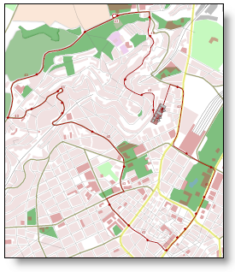

Slide 15
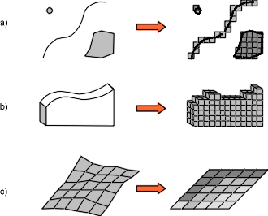
Modeling Geometries: The Raster based Approach
Yes raster is faster, but raster is vaster, and vector just seems more correcter [C.D. Tomlin 1990]

Slide 16
Data Sources
and
Data Collection

Slide 17
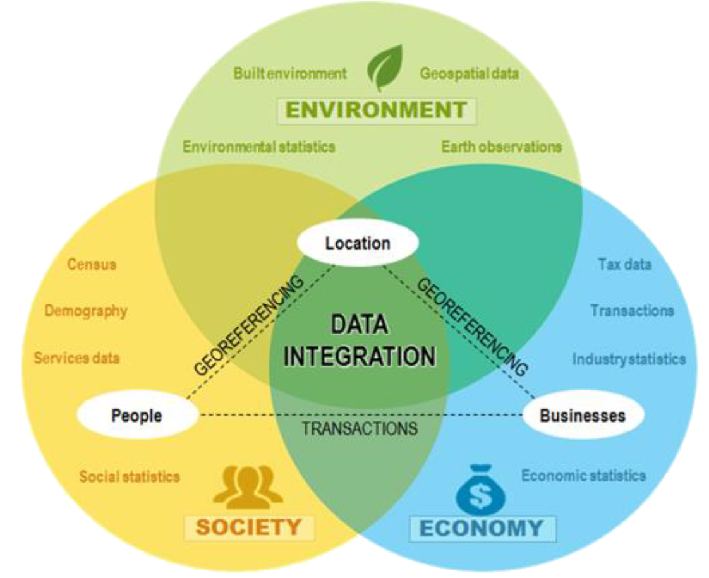
Geodata: The nexus between Society, Economy and Environment
Source: Geoscience Australia, by
https://www.gwprime.geospatialworld.net/opinion/the-power-of-where-it-begins-with-geodesy/?utm_source=GW+Subscribers&utm_campaign=8b9b6a8e7f-GWPrime-free-Annual-reg-offer-2ndmailer-16Apr&utm_medium=email&utm_term=0_3b0a203c48-8b9b6a8e7f-139787745 and https://ggim.un.org/meetings/2021/Global_Geodesy_Forum/documents/Global_Geodesy_Forum-Presentation.pdf [2022-10-02]
Notes:
Geodesy underpins the three pillars of sustainable development, providing data and services to support societal benefits, economic prosperity and environmental monitoring | Courtesy: Geoscience Australia
https://www.gwprime.geospatialworld.net/opinion/the-power-of-where-it-begins-with-geodesy/?utm_source=GW+Subscribers&utm_campaign=8b9b6a8e7f-GWPrime-free-Annual-reg-offer-2ndmailer-16Apr&utm_medium=email&utm_term=0_3b0a203c48-8b9b6a8e7f-139787745

Slide 18
National Mapping Agency
Data Collection in the Field
NGO
Data Collection in the Field
Other National Agency
Statistical Agencies
UN
World Bank
International Data Suppliers
Surveying
Surveying
(Geo)
Data
Surveying
Social Media Data
Citizen Science
LiDAR
Volunteered Geogtaphic Information
Earth Observation Data
Remotely Sensed Imagery
RADAR
GNSS
NGO
Tabular Data
Remote Sensing: to capture the status at a given time and to identify, understand and estimate the pattern of changes
GNSS: Global Navigation Support System
NGO: Non-Governmental Organisation

Slide 19
Processing the Data:
GIS and other Geospatial Tools

Slide 20
GIS – Geographic Information Systems: Definitions I
A system for capturing, storing, checking, integrating, manipulating, analyzing and displaying data which are spatially referenced to the Earth (DoE 1987).
A Geographical Information System can process georeferenced data and provide the answers to questions involving ... the particulars of a given location, the distribution of selected phenomena, the changes that have occured since a previous viewing, the impact of a specific event, or the relationships and systematic patterns of a region (Bernhardsen 1999).

Slide 21
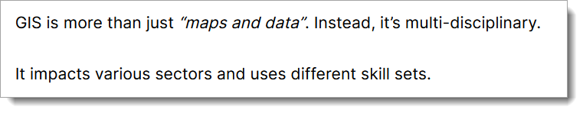
GIS – Geographic Information Systems: Definitions II
https://gisgeography.com/gis-dictionary-definition-glossary/ [2022-10-23]

Slide 22
Other Tools
Geospatial Libraries (GDAL)
ETL Tools (Extract from DBs, Transform, Load into other repositories)
Powerful spatially enabled DBMS
Server-side solutions for geospatial web services
GIS and other tools enable interoperable collaboration, but…

Slide 23
Different Disciplines have different Vocabularies, Models, Object Classes and Encodings
1. Biotechnology
2. Biochemistry
3. Botany
4. Chemistry
5. Computer Science
6. Electronics
7. Fisheries
8. Forensic Science
9. Geology
10. Geography
11. Horticulture
12. Mathematics
13. Microbiology
14. Pharmaceutical Chemistry
15. Physics
16. Seed Technology
17. Statistics
18. Zoology
and can contribute for the benefit of all.

Slide 24
Our Contribution to Fundamental Datasets
Fundamental Data Sets
The INSPIRE Data Themes
Data relevant for Digital Twins

Slide 25
The Concept of Global Fundamental Geospatial Data Themes
“Fundamental data sets are the minimum primary sets of data that cannot be derived from other data sets, and that are required to spatially represent phenomena, objects, or themes important for the realisation of economic, social, and environmental benefits consistently across Africa at the local, national, sub-regional and regional levels.”
Source: Geoinformation in Socio-Economic Development: Determination of Fundamental Datasets for Africa; Published by the United Nations Economic Commission for Africa, 2007, Addis Abeba, Ethiopia.
http://ggim.un.org/meetings/GGIM-committee/9th-Session/documents/Fundamental_Data_Publication.pdf
[2019-11-17]

Slide 26
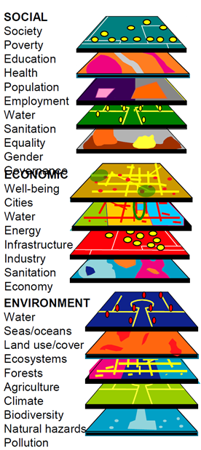

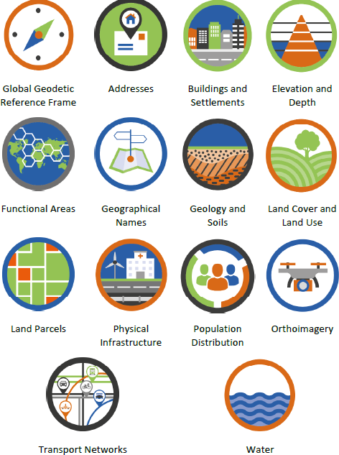
The Global Fundamental Geospatial Data Themes
based on
https://ggim.un.org/meetings/GGIM-committee/9th-Session/documents/Fundamental_Data_Publication.pdf [2022-11-06]

Slide 27
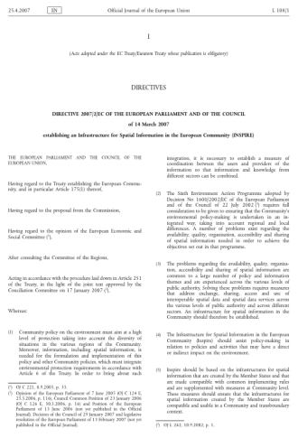
The EU INSPIRE Directive (2007)
General rules to establish an Infrastructure for Spatial Information in Europe for environmental policies
Spatial data held by/on behalf of public authorities
Does not require collection of new data
http://eur-lex.europa.eu/legal-content/EN/TXT/PDF/?uri=CELEX:32007L0002&from=EN
https://eur-lex.europa.eu/legal-content/DE/TXT/HTML/?uri=CELEX:02007L0002-20190626&qid=1642582408199&from=DE
Notes:
Vlado Cetl: INSPIRE principles, components and implementation. http://www.inspire.gv.at/dms/inspire/dateien/INSPIRE-Training-2014--Aalborg-DK/INSPIRE-Training-2014---Teil-2---principles--components-and-implementation/INSPIRE%20Training%202014%20-%20Teil%202%20-%20principles,%20components%20and%20implementation.ppt
Environmental phenomena (and disasters) do not stop at national borders!
20% of the EU citizens (115 million) live within 50 km from a border.
70% of all fresh water bodies in Europe are part of a trans-boundary river basin.

Slide 28
INSPIRE Data themes
Annex III
  Statistical units
  Buildings
  Soil
  Land use
  Human health and safety
  Utility and governmental services
  Environmental monitoring facilities
  Production and industrial facilities
  Agricultural and aquaculture facilities
  Population distribution – demography
  Area management/restriction
  /regulation zones & reporting units
  Natural risk zones
  Atmospheric conditions
  Meteorological geographical features
  Oceanographic geographical features
  Sea regions
  Bio-geographical regions
  Habitats and biotopes
  Species distribution
  Energy Resources
  Mineral resources
Annex I
  Coordinate reference systems
  Geographical grid systems
  Geographical names
  Administrative units
  Addresses
  Cadastral parcels
  Transport networks
  Hydrography
  Protected sites
Annex II
  1. Elevation
  2. Land cover
  3. Ortho-imagery
  4. Geology
https://eur-lex.europa.eu/legal-content/EN/TXT/HTML/?uri=OJ:L:2007:108:FULL&from=EN [2022-10-23]
Notes:
1. Biotechnology 2. Biochemistry 3. Botany 4. Chemistry 5. Computer Science 6. Electronics 7. Fisheries 8. Forensic Science 9. Geology 10. Geography 11. Horticulture 12. Mathematics 13. Microbiology 14. Pharmaceutical Chemistry 15. Physics 16. Seed Technology 17. Statistics 18. Zoology

Slide 29
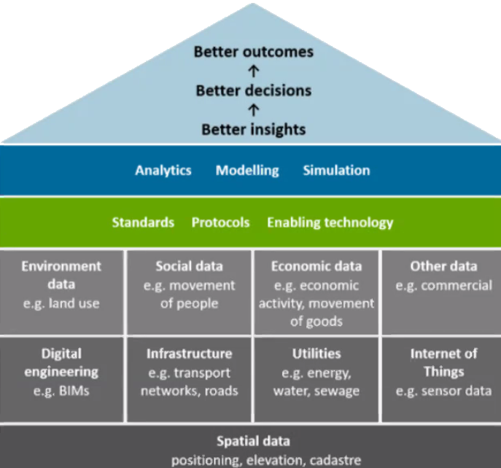
ANZLIC‘s Data Scheme for Digital Twins
https://www.anzlic.gov.au/resources/principles-spatiallv-enabled-digital-twins-built-and-natural-environment-australia

Slide 30
Sharing Models and Data

Slide 31
Sharing Models and Data
Interoperable data Distribution and dissemination need common data models and encodings.
Encodings:
  XML-based
  JSON-based
<LineString srsName="http://www.opengis.net/gml/srs/epsg.xml#4326">
<coordinates>100.0,100.0 230.0,80.0 350.0,130.0 </coordinates>
</LineString>
{
"type": "Feature",
"geometry": {
"type": "Point",
"coordinates": [125.6, 10.1]
},
"properties": {
"name": "Dinagat Islands"
}
}
https://geojson.org/

Slide 32
The Internet is omnipresent:
Web Based Interoperability

Slide 33

Architecture: From GIS to Web-based Data delivery
DNS Server
IP address
IP address / Server Name / Host name
Client
"User Agent"
HTTP Server
Document root
Static
resources
HTTP-Client
HTTP-Client
HTTP-Client
HTTP
HTTP
80
Internet
80
Communication Tier,
Web Tier
PNG, JPG, …
XML / SVG
Presentation Tier
CGI protocol
Application
Server
Server side programs
Dynamic Generation of resources
Local System
(GIS)
App Tier,
Business Logic Tier
SQL
Data collection, preparation, analysis
DBMS
Server
Data Tier
like Geodata

Slide 34
Architecture: From GIS to web-based Data delivery
DNS Server
IP address
IP address / Server Name / Host name
URI
RFC 1630
Client
"User Agent"
HTTP Server
HTTP
RFC 2616
Content-Type
RFC 2045
Document root
Static
resources
HTTP-Client
HTTP-Client
HTTP-Client
HTTP
HTTP
80
Internet
80
Communication Tier,
Web Tier
PNG, JPG, …
XML / SVG
Presentation Tier
XML
w3.org/XML/
CGI protocol
CGI
RFC 3875
Application
Server
Server side programs
Dynamic Generation of resources
Local System
(GIS)
App Tier,
Business Logic Tier
SQL
ISO/IEC 9075
SQL
Data collection, preparation, analysis
DBMS
Server
SFA
OGC/SO 19125-2
Data Tier
like Geodata

Slide 35
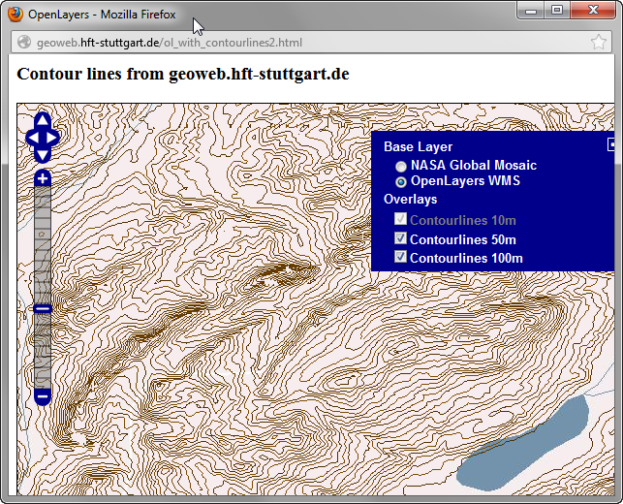
A (Geo-) Web Service Example: Contour Lines
DNS Server
1
4
Request in Web Brwoser/IT Solution
URI
RFC 1630
IP address
Transfer
IP address / Server Name / Host name
Client
"User Agent"
http://geoweb.hft-stuttgart.de/service=wms&operation=getmap...
Content-Type
RFC 2045
HTTP
RFC 2616
Webserver
Document root
Static
resources
HTTP-Client
HTTP-Client
HTTP-Client
HTTP
HTTP
80
Image/png
Internet
80
Communication Tier,
Web Tier
Web Map Service
PNG, JPG, …
XML / SVG
3
CGI
RFC 3875
CGI protocol
Data rendering
5
Geospatial Portal Sites
Presentation Tier
Application
Server
Presentation
Server side programs
Dynamic Generation of resources
2
Local GIS
WMS
OGC/SO 19128
Data retrieval
SQL
ISO/IEC 9075
Application Tier,
Business Logic Tier
SQL
Data preparation, analysis
DBMS
Server
Geometries (contour lines)
(Simple Features)
Data Tier
SFA
OGC/SO 19125-2

Slide 36
A (Geo-) Web Service Example: Contour Lines
DNS Server
http://geoweb.hft-stuttgart.de/ol_with_contourlines2.html
IP address
URI
RFC 1630
IP address / Server Name / Host name
Client
"User Agent"
Content-Type
RFC 2045
HTTP
RFC 2616
Webserver
Document root
Static
resources
HTTP-Client
HTTP-Client
HTTP-Client
HTTP
HTTP
80
text/xml
Web Feature Service
Internet
80
Communication Tier,
Web Tier
PNG, JPG, …
XML / SVG
<contour height="550.0">
<gml:lineStringProperty>
<gml:LineString
srsName="http://www.opengis.net/gml/srs/epsg.xml#4326">
<gml:coordinates>
9510.0,4333.0 9536.4,4320.1 9555.5,4310.7
</gml:coordinates>
</gml:LineString>
</gml:lineStringProperty >
</contour>
CGI
RFC 3875
CGI protocol
Geospatial Portal Sites
Presentation Tier
Application
Server
Server side programs
Dynamic Generation of resources
Local GIS
GML
OGC/SO 19136
Application Tier,
Business Logic Tier
SQL
ISO/IEC 9075
Data Presentation
SQL
Data preparation, analysis
DBMS
Server
Geometries (contour lines)
(Simple Features)
Data Tier
SFA
OGC/SO 19125-2

Slide 37
Geospatial Portal Sites
“a standardized and decentralized spatial information management environment, designed to enable access to geo-referenced databases, cartographic products and related metadata […], enhancing the spatial information exchange and sharing between organizations and their audience, using the capacities of the internet.”
“… facilitating a wide community of spatial information users to have easy and timely access to available spatial data […] that might support informed decision making.”
Very often based on Open Source, supporting international standards like
  OGC-CSW 2.0.2 ISO Profile, ISO 19115 (Geographic information – Metadata) / ISO 19119 (Geographic information – Services)/ ISO 19110 (Geographic information -- Methodology for feature cataloguing) / ISO 19139 (Geographic information Metadata XML schema implementation), Open Archives Initiative Protocol for Metadata Harvesting (OAI-PMH), ISO 23950 Information Retrieval (Z39.50)
http://geonetwork.grid.unep.ch/geonetwork/srv/en/about

Slide 38
Further/Upcoming Fields of
Application

Slide 39
Further Fields of Application
3D data
  Smart Cities and Digital Twins (i.e. digital infrastructure engeneering systems with integration of real time data).
Large volumes of Earth Observation data (free or costly)
Autonomous driving vehicles
AI and Machine Learning

Slide 40
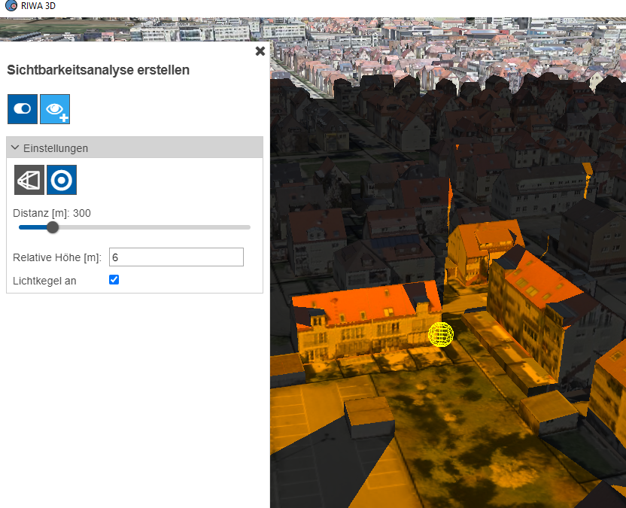
Quelle: Josua Steffan, Stadt Fellbach, E-Mail-Kommunikation 2022-10-21.

Slide 41
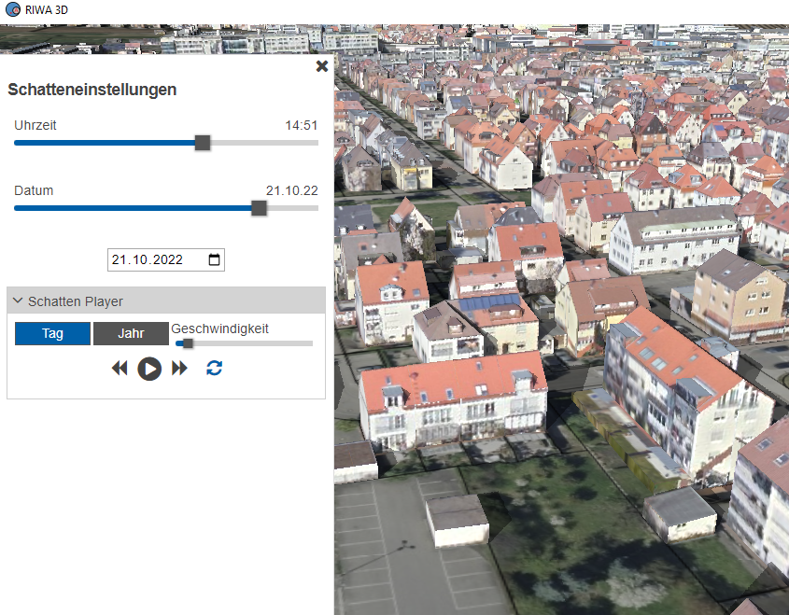
Quelle: Josua Steffan, Stadt Fellbach, E-Mail-Kommunikation 2022-10-21.

Slide 42
Spatially enabled Digital Twins
The modelling concept comprises [Aryal Jagganath, 2022]:
  “physical Entities and Processes in Real Environment,
  virtual Entities and Processes in Digital Environment,
  the connection and exchange of information in IT systems that bonds and orchestrates the virtual and physical environments in at a specified frequency and fidelity (Oclott & Mullen, 2020).”
A digital twin is “a platform for open and shared data, community engagement, performance reporting and investment optimisation. We believe that along with data trusts and data exchanges, digital twins present significant potential…” [https://www.smartcitiescouncil.com/article/how-are-you-looking-digital-twin]

Slide 43
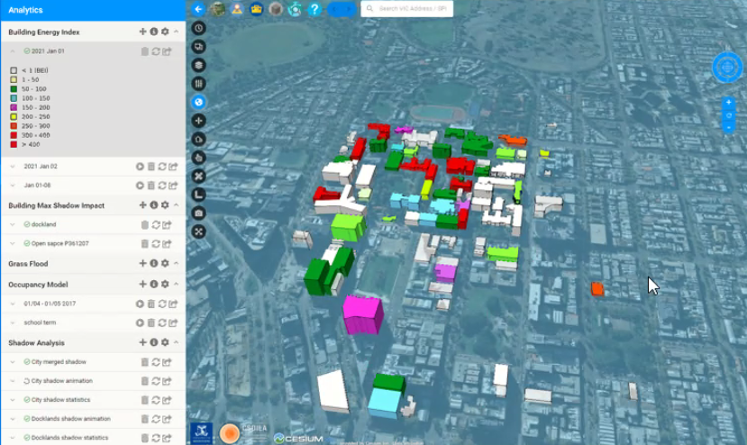
Energy Consumption Estimation

Slide 44
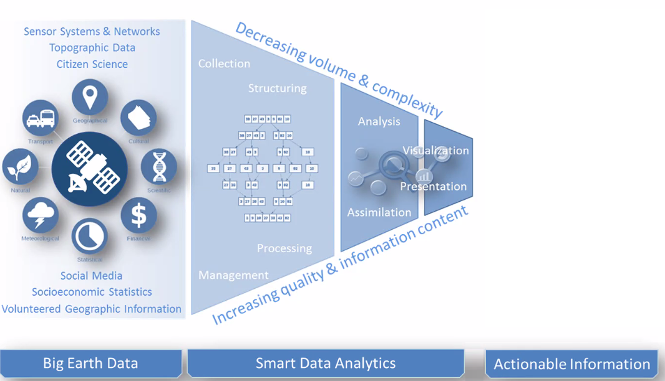
From Big Data to Action
Analysis
Appraisal
Decision
Source: Modified after Esch, Thomas, AGSE 2022

Slide 45
Education
and
Career Opportunities

Slide 46
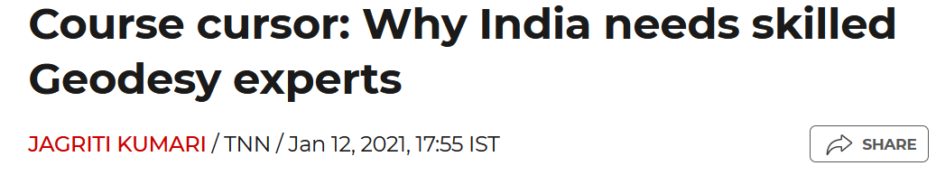
https://timesofindia.indiatimes.com/education/news/course-cursor-why-india-needs-skilled-geodesy-experts/articleshow/80233837.cms
… and how my University can contribute to academic education – see separate presentation!

Slide 47
Summary and a Sort Outlook to “Green Deal”

Slide 48
Data Models
  represent our understanding of our environment,
  Need to be collaboratively developed in a consensus process
  need to be formalized for IT
(Geo) Data
  are a prerequisite for modern societies, privately and in the public for informed decision making
  Have to be stored in geo databases
  Have to be findable, accessible, interoperabl and reusable
Standards and appropriate (Open Source based ) IT tools support interoperable usage of data.
Education must support ethical use of data and modern technologies – our duty a educators.

Slide 49
Green Data for All (2021)
With the European Green Deal, the European Commission calls for "investors, insurers, cities and citizens across the EU to have access to data" in order to include it in their risk management in the context of climate change, among other things.
Accessible and interoperable data is seen as the focal point of data-driven investments, as it facilitates evidence-based decisions and strengthens capabilities to understand and address environmental challenges, in combination with digital infrastructures and artificial intelligence solutions.
In addition, the Green Deal identifies an accurate digital model of the Earth as a goal and highlights the opportunities for remote monitoring of air and water pollution or optimising the use of energy and natural resources, as opened up for the first time by digitalisation.

